Slide 1
DBT – Review of Distress Tolerance Skills –
Crisis Survival Skills

Slide 2
Crisis survival skills
STOP
Pros/Cons
TIP your body chemistry
Distract with Wise Mind ACCEPTS
Self-Soothe – Five Senses
IMPROVE the Moment

Slide 3
When to use crisis survival skills
Use when:
Crisis is short term
Pain can’t be solved right away
Emotion mind threatens to make the situation worse
Arousal is extreme, but you have to carry on anyway
Don’t use:
For everyday problems
To solve all life problems
To avoid finding a long-term solution

Slide 4
s.t.o.p.
S. – Do not react. Stop. Don’t allow your emotions to make you act without thinking.
T. – Take a step back. Take a break. Take a breath.
O. – Observe what’s going on inside and outside you; thoughts, feelings, behaviours of others.
P. – Proceed mindfully and effectively. Ask Wise Mind: Which actions will make this better or worse?

Slide 5
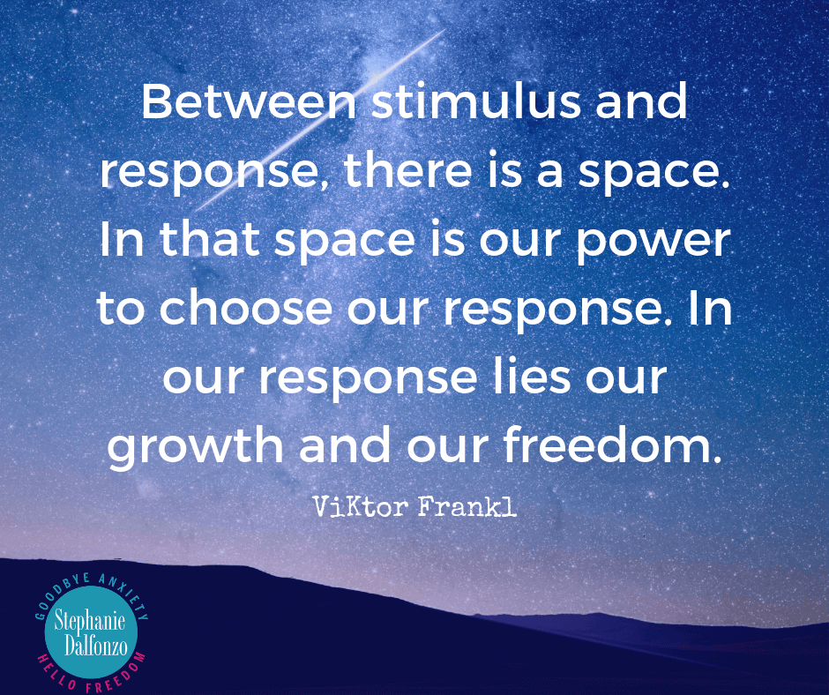

Slide 6
Pros and Cons
What is my crisis urge? (yelling, using substances, eating another piece of chocolate cake, posting that comment on FB?)
What are the pros of acting on a crisis urge?
What are the cons of acting on a crisis urge?
What are the pros of not acting on the crisis urge?
What are the cons of not acting on the crisis urge?
Revisit the positive and negative consequences whenever the urge resurfaces.

Slide 7
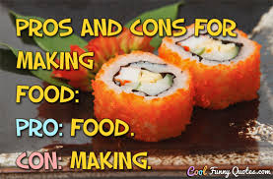
Just for a Giggle…

Slide 8
T.I.P.-to reduce extreme emotion fast
T. - tip the temperature of your face with cold water – lowers your heart rate for a short time
I. – Intense exercise. Expel your body’s pent up energy. Run, jump, walk briskly, lift weights, play basketball…
P. – Paced breathing. Slow your breath on purpose. Breathe out longer than you breathe in.
P. – Paired muscle relaxation. Breathe in and tense your body. Breathe out and say “relax” while letting go of tension.

Slide 9
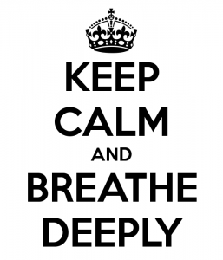

Slide 10
Wise mind A.C.C.E.P.T.S.
The occasional use of distraction helps to reduce emotion mind.
A. – Activities. Do something you love.
C. – Contributing. Do something nice for someone else.
C. – Comparisons. Remind yourself that you’ve felt worse before and managed to find a way through.
E. – different Emotions. Elicit a different emotion by listening to music, watching a movie, reading a book….
P. – Push Away the strong emotions. Block the thoughts from your mind. Tell your mind “no”.
T. – think of other Thoughts. Count to 10. Count colours on the wall. Do a puzzle.
S. – Sensations. Squeeze a ball very hard. Hold ice in your hand. Suck on a lemon. Take a cold shower.

Slide 12
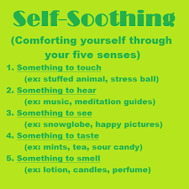

Slide 13
I.M.P.R.O.V.E the moment
When feeling overwhelmed in a stressful situation that may last awhile use:
I. – Imagery. Imagine relaxing scenery, or a comforting place.
M. – Meaning. Find a purpose for the painful situation. P. – Prayer. Ask for strength. Open your heart to your Wise Mind. R. – Relax. Massage your neck. Breathe deeply. Drink warm liquids.
O. – One Thing in the Moment. One-mindfulness. Just this one thing. V. – brief Vacation. Read a magazine and eat chocolates. Go for a walk in the woods. Turn your phone off for the day.
E. – Encouragement. Be your own cheerleader. “It won’t last forever.””I got this.””I can stand it.”

Slide 14
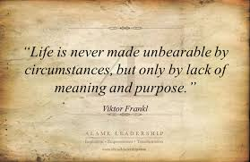

Slide 15
Remember:
Crisis Survival Skills are short-term coping strategies for painful situations that cannot be solved right away. They can help you tolerate the moment without making things worse.
These skills must be followed by problem-solving/change skills in order to move forward with living your best life.

